Slide 1


Slide 2
CHAPTER 1
Semiconductors & Diodes

Slide 3
Semiconductor & Diodes
Semiconductor Materials: Ge, Si, and GaAs
Atomic Structure
Covalent Bonding
Energy Levels
n-Type and p-Type materials
Majority and Minority carriers
p-n Junctions
Diodes
Diode Operating Conditions
Actual Diode Characteristics
Diode equation

Slide 4
Semiconductor Materials: Ge, Si, and GaAs
Semiconductors are a special class of elements having a conductivity between that of a good conductor and that of an insulator.
They fall into two classes : single crystal and compound·
Single crystal : Germanium (Ge) and silicon (Si).
Compound : gallium arsenide (GaAs),cadmium sulfide (CdS),gallium nitride (GaN),gallium arsenide phosphide (GaAsP)
The three semiconductors used most frequently in the construction of electronic devices are Ge, Si, and GaAs.

Slide 5
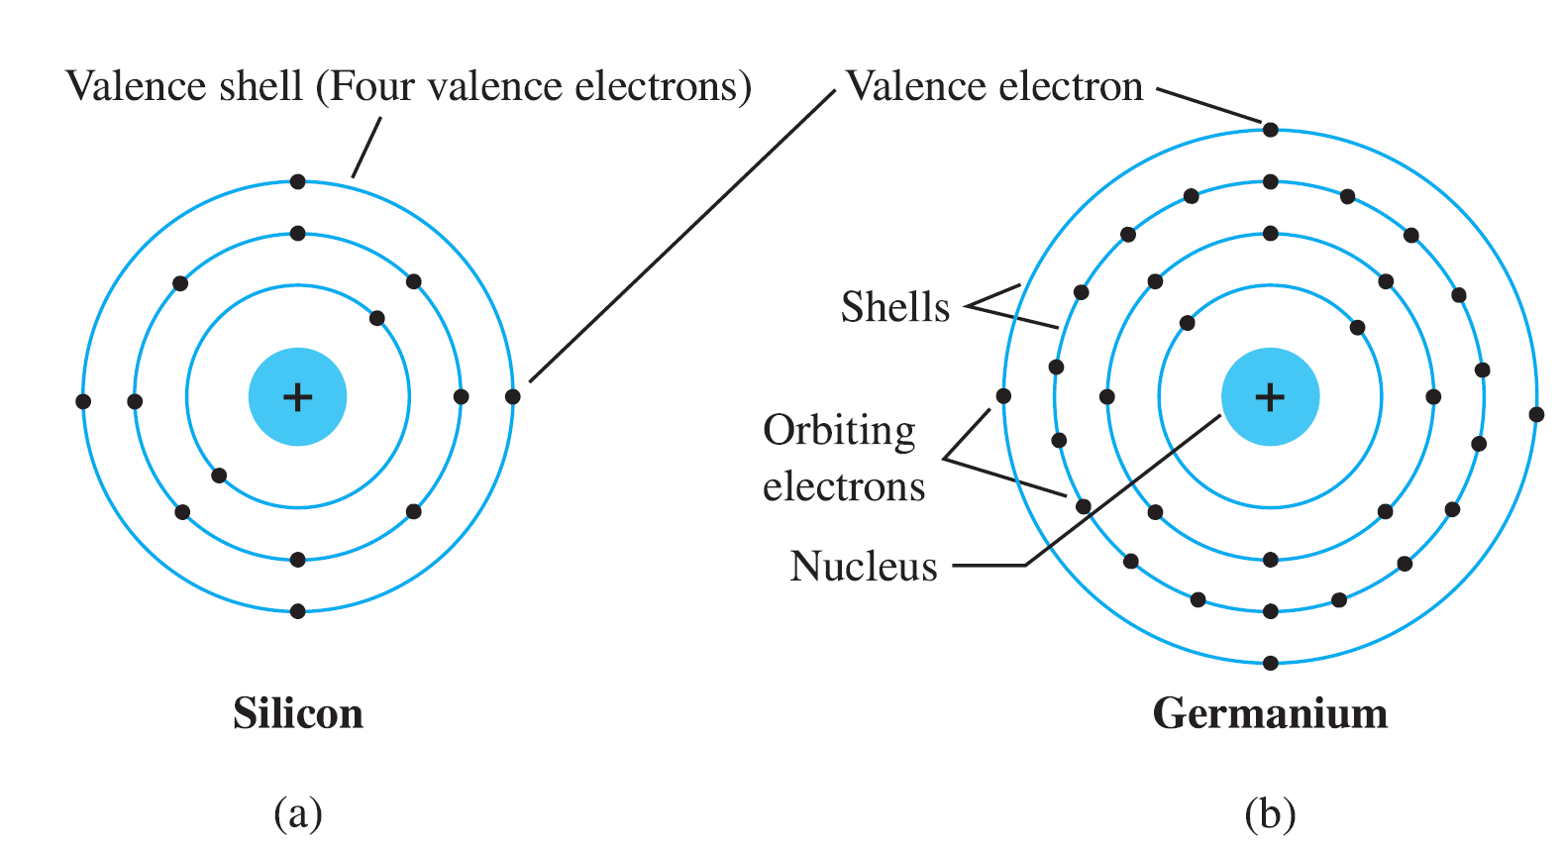
Atomic Structure
Valence electrons: electrons in the outermost shell.·
Atoms with four valence electrons are called tetravalent.

Slide 6
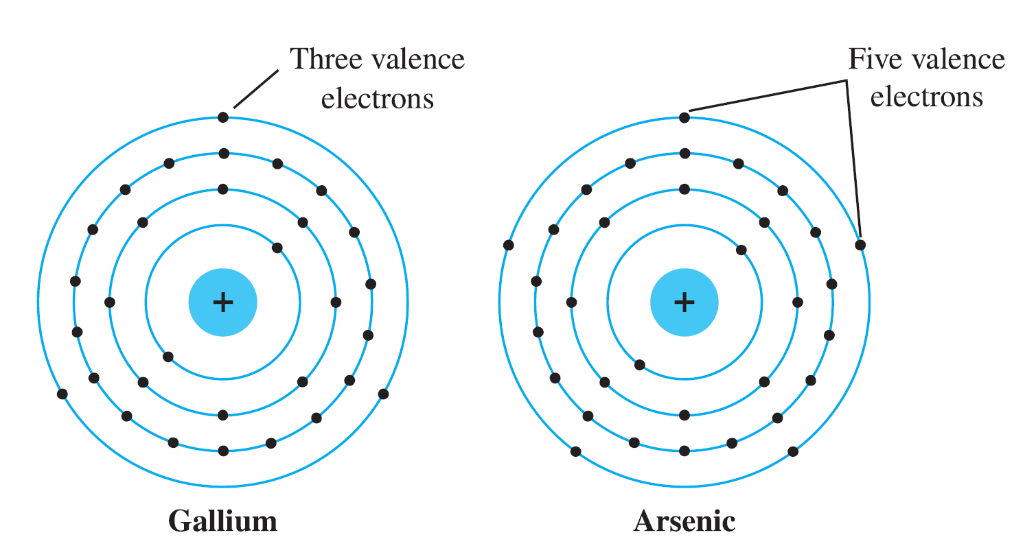
Atomic Structure
Atoms with three valence electrons are called trivalent, and those with five are called pentavalent.

Slide 7
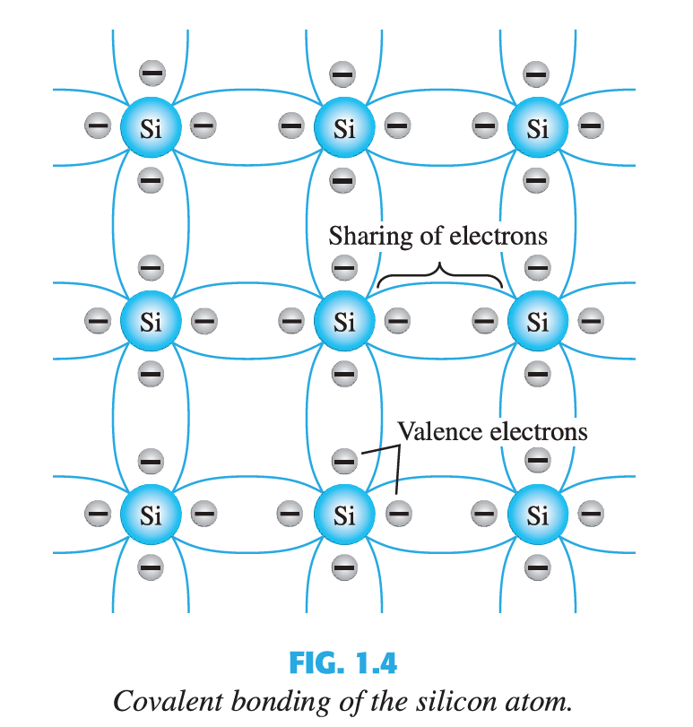
Covalent Bonding
This bonding of atoms, strengthened by the sharing of electrons , is called covalent bonding

Slide 8
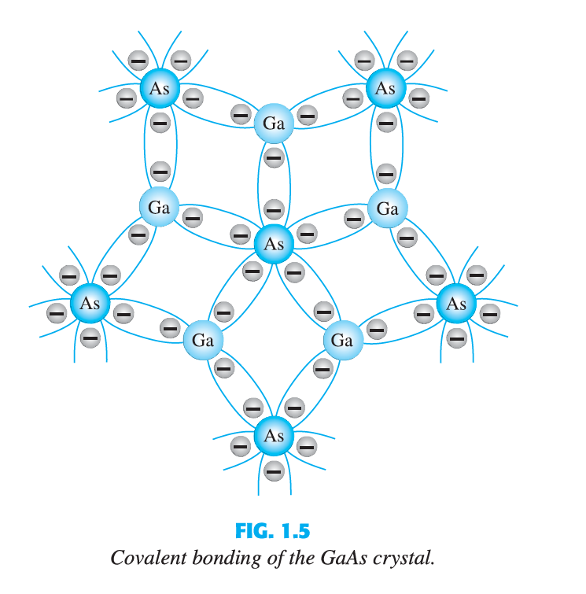
Covalent Bonding
There is sharing of electrons, five electrons provided by As atom and three by the Ga atom.

Slide 9
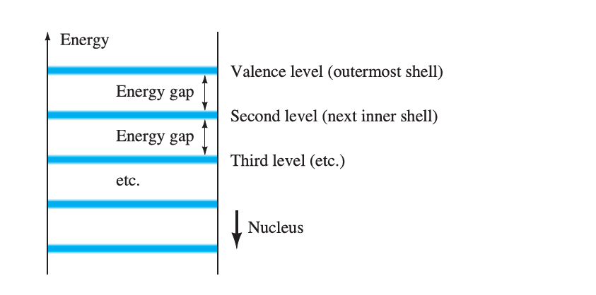
Energy Levels
The farther an electron is from the nucleus, the higher is the energy state.

Slide 10
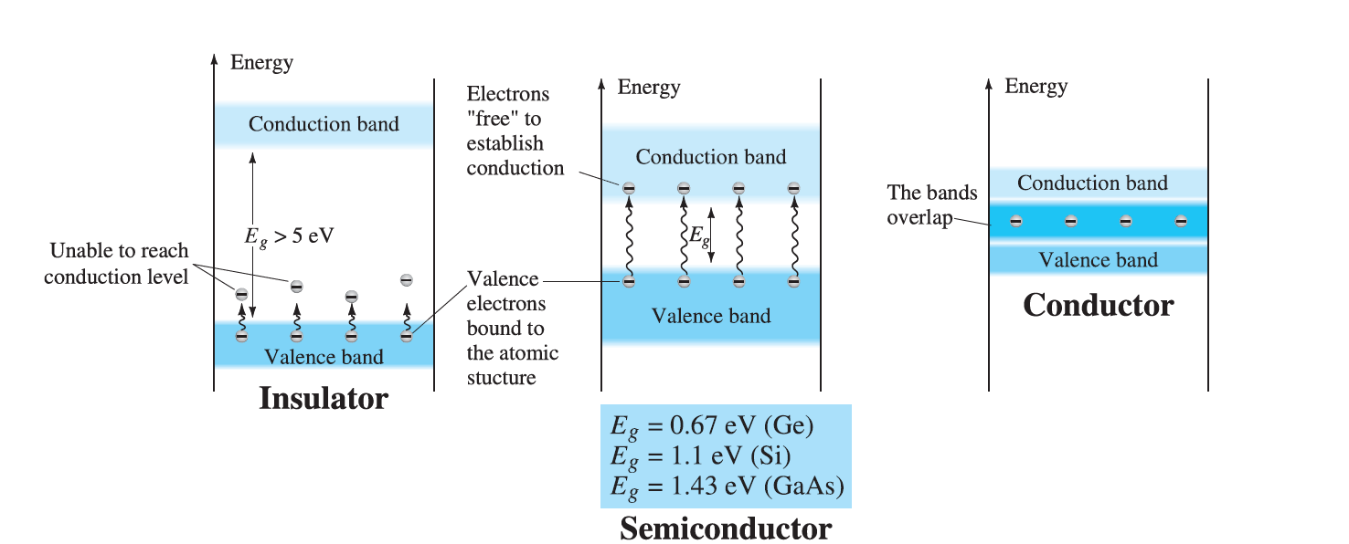
Energy Levels
An electron in the valence band of silicon must absorb more energy than one in the valence band of germanium to become a free carrier. [free carriers are free electrons due only to external causes such as applied electric fields established by voltage sources or potential difference.

Slide 11
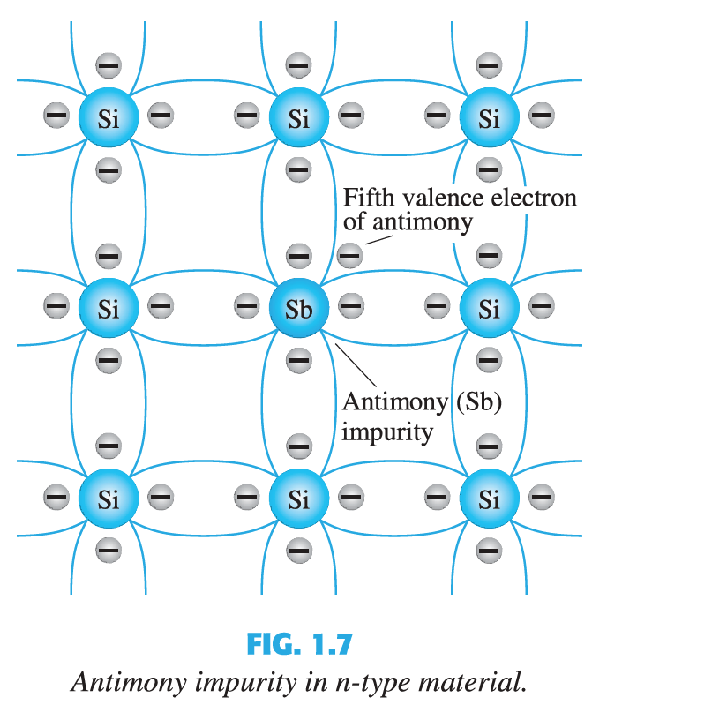
n-Type and p-Type materials
n-Type Material
n-Type materials are created by adding elements with five valence electrons such as antimony, arsenic , and phosphorous.
There is a fifth electron due to the (Sb) atom that is relatively free to move in the n-Type material.
The atoms (in this case is antimony (Sb)) are called donor atoms.
Doping with Sb, (antimony)

Slide 12
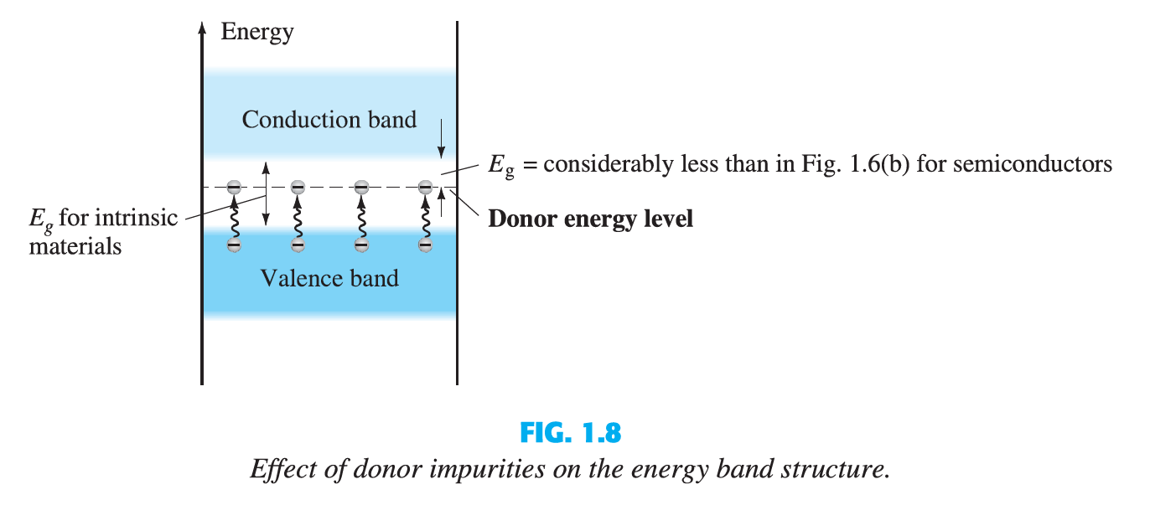
n-Type and p-Type materials
n-Type Material
The free electrons due to the added atoms have higher energy levels and require less energy to move to conduction band.

Slide 13
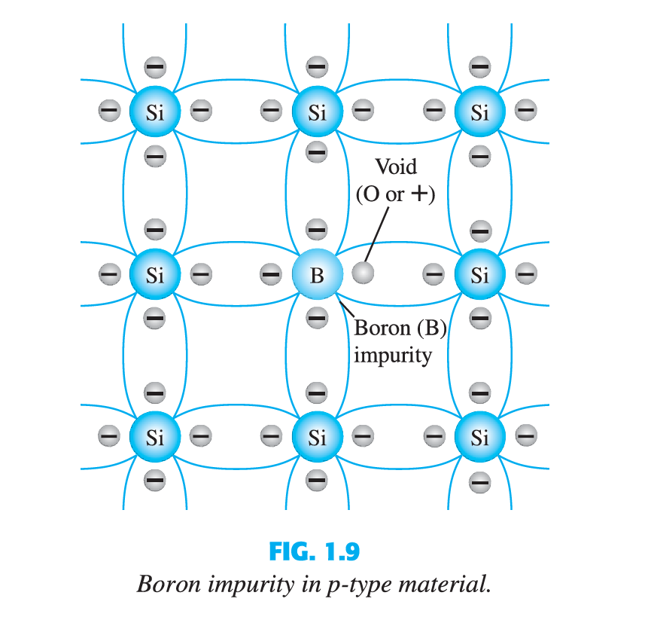
n-Type and p-Type materials
p-Type materials
p-Type materials are created by adding atoms with three valence electrons such as boron, gallium, and indium.
In this case, an insufficient number of electrons to complete the covalent bonds.
The resulting vacancy is called a "hole" represented by small circle or plus sign indicating absence of a negative charge.
The atoms (in this case boron(B))are called acceptor atoms.

Slide 14
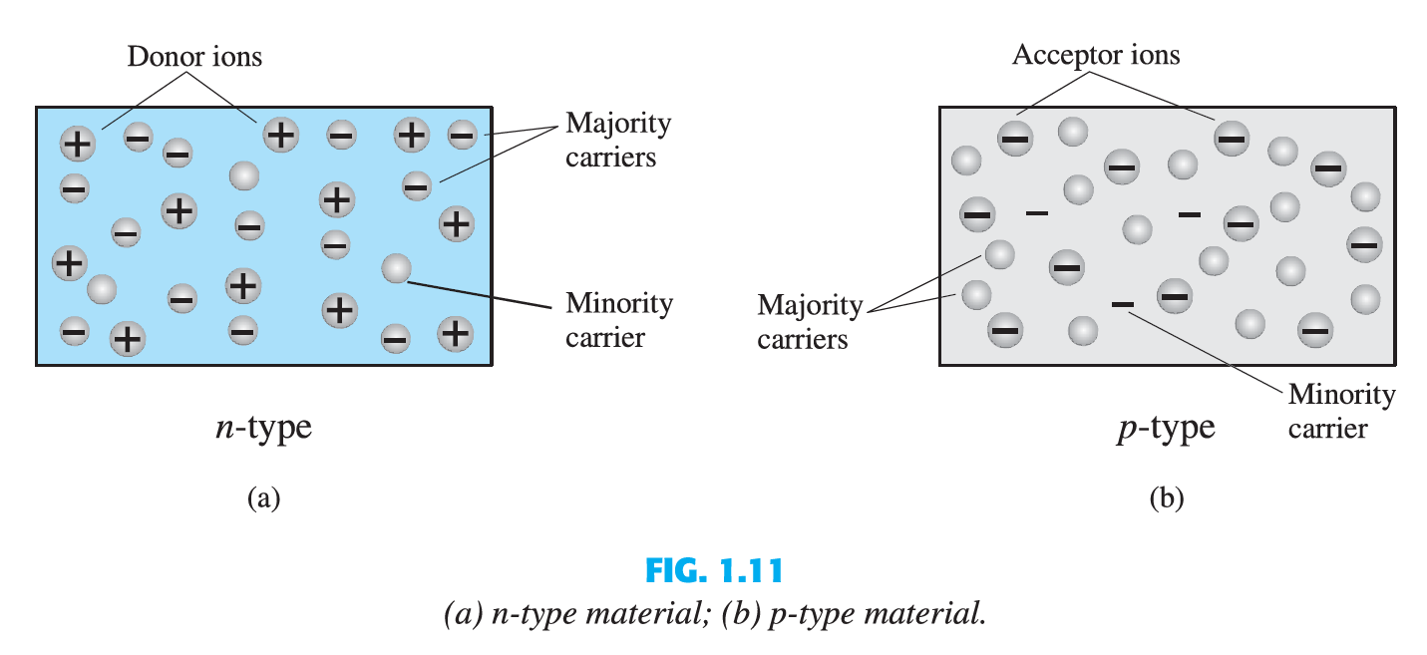
Majority and Minority carriers
Two currents through a diode:
Majority Carriers
The majority carriers in n-type materials are electrons.
The majority carriers in p-type materials are holes.
Minority Carriers
The minority carriers in n-type materials are holes.
The minority carriers in p-type materials are electrons.

Slide 15
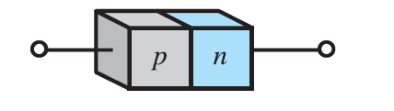
p-n Junctions
One end of a silicon or germanium crystal can be doped as a p-type material and the other end as an n-type material.
The result is a p-n junction.

Slide 16
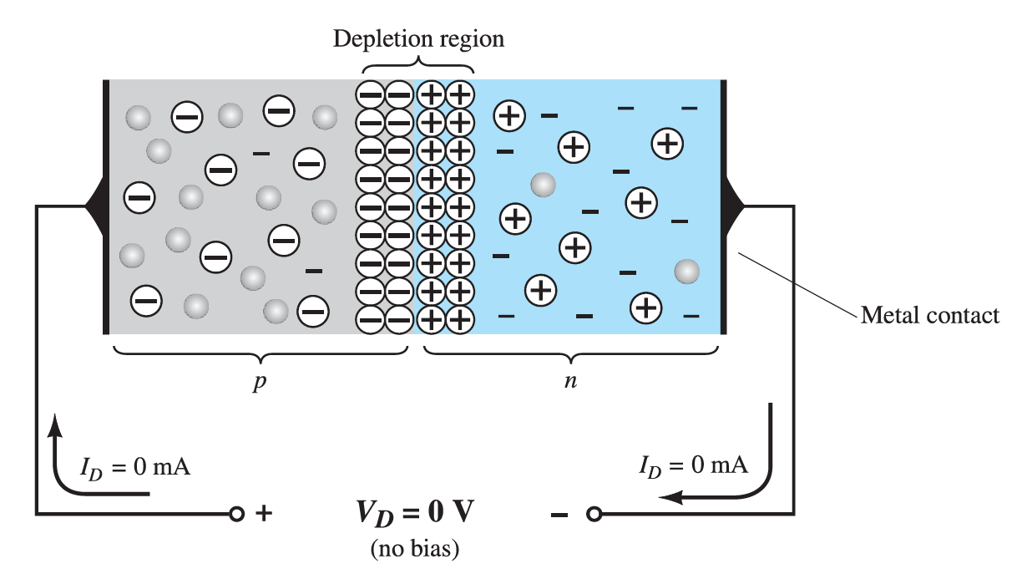
p-n Junctions
At the p-n junction, the excess conduction-band electrons on then-type side are attracted to the valence-band holes on the p-type side.
The electrons in the n-type material migrate across the junction to the p-type material(electron flow).
The electron migration results in a negative charge on the p-type side of the junction and a positive charge on the n-type side of the junction.
The result is the formation of a depletion region around the junction.

Slide 17
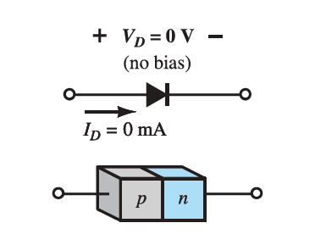
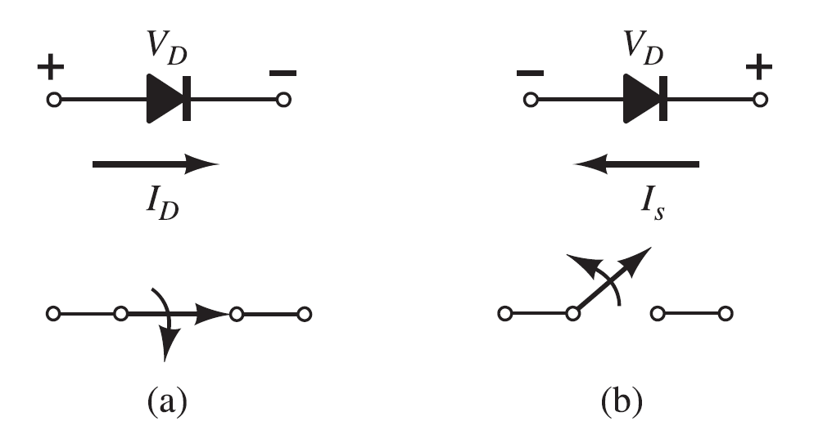
Diodes
The diode is a 2-terminal device.
A diode ideally conducts in only one direction.

Slide 18
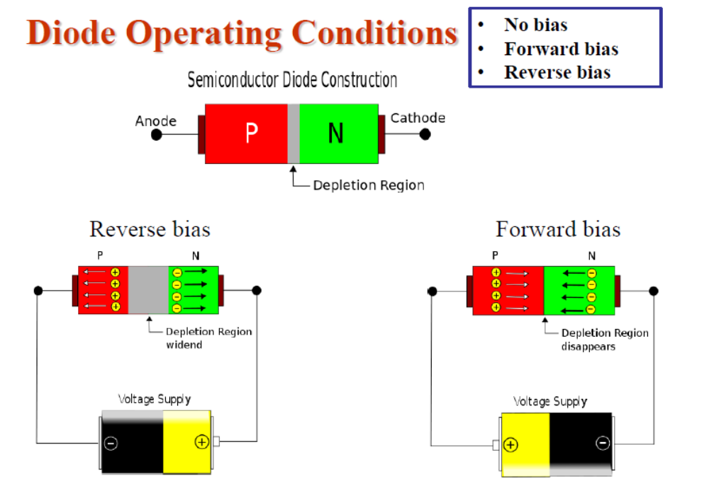

Slide 19
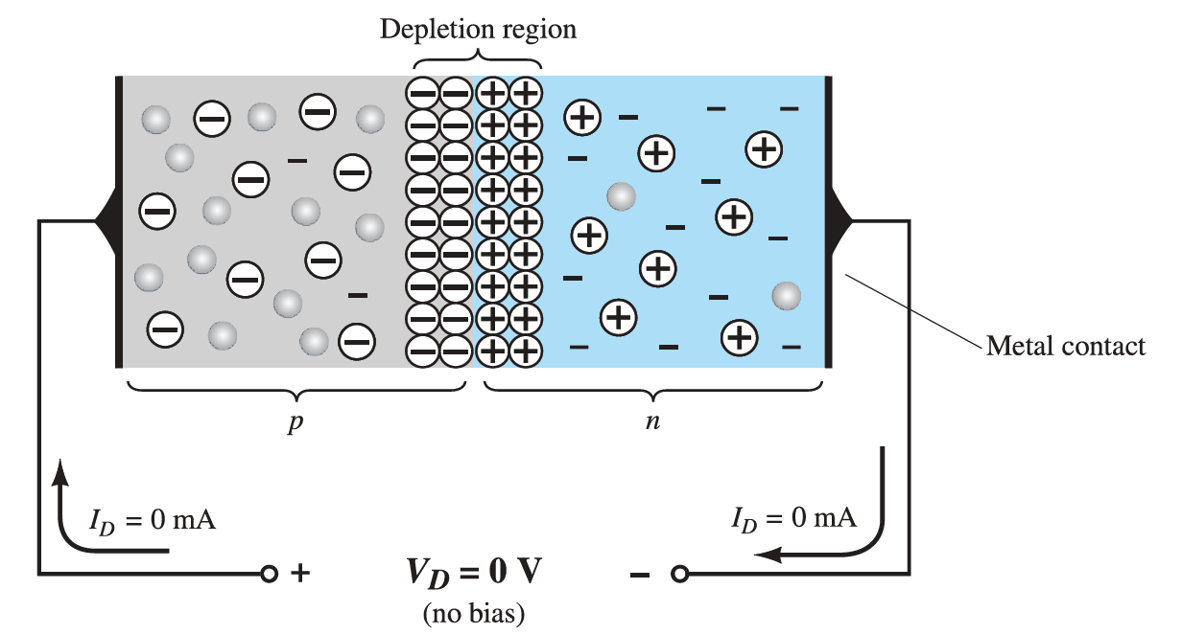
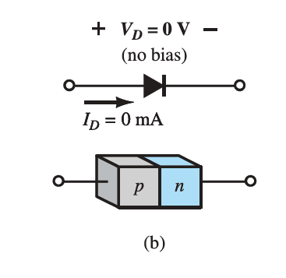
Diode Operating Conditions
No Bias
No external voltage is applied: VD=0 V
No current is flowing: ID=0 A
Only a modest depletion region exists

Slide 20
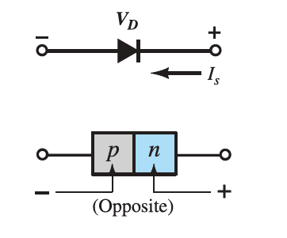
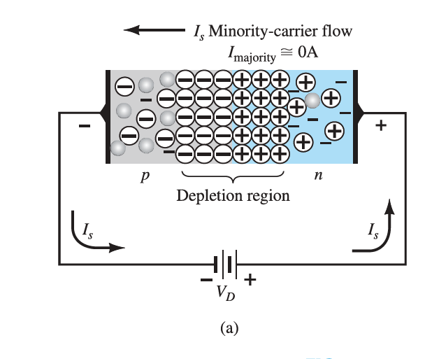
Diode Operating Conditions
Reverse Bias
External voltage is applied across the p-n junction in the opposite polarity of the p- and n-type materials.
The reverse voltage causes the depletion region to widen.
The electrons in the n-type material are attracted toward the positive terminal of the voltage source.
The holes in the p-type material are attracted toward the negative terminal of the voltage source.

Slide 21
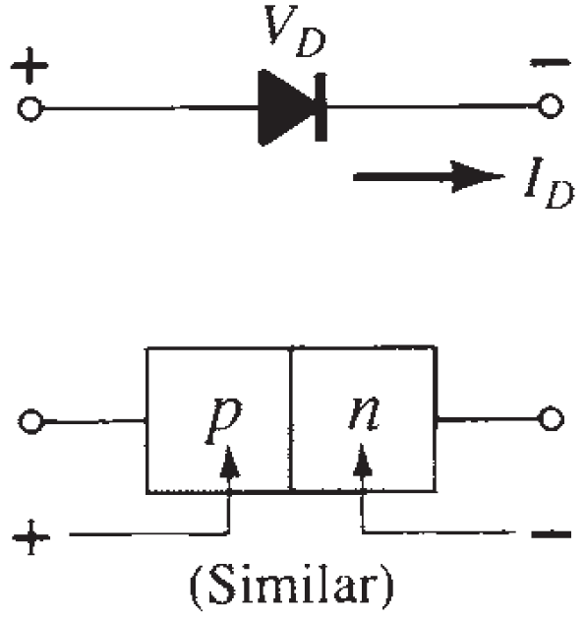
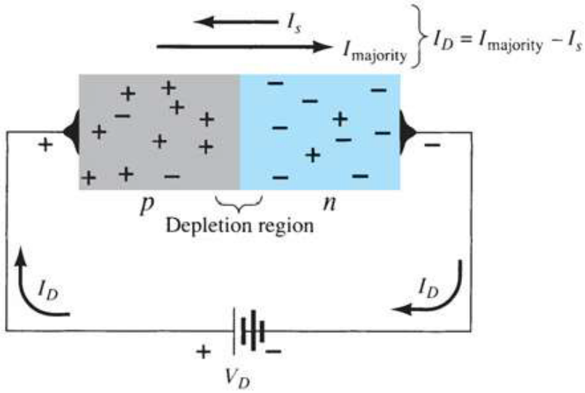
Diode Operating Conditions
Forward Bias
External voltage is applied across the p-n junction in the same polarity as the p- and n-type materials.
The forward voltage causes the depletion region to narrow.
The electrons and holes are pushed toward the p-n junction.
The electrons and holes have sufficient energy to cross the p-n junction.

Slide 22
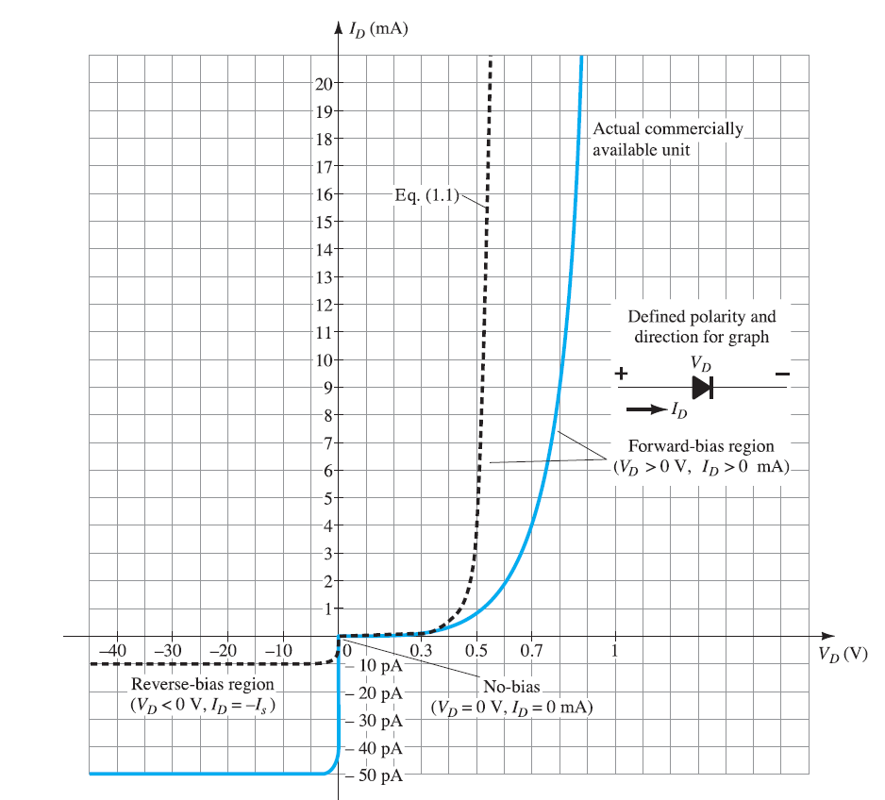


Actual Diode Characteristics
Note the regions for no bias, reverse bias, and forward bias conditions.
Carefully note the scale for each of these conditions.
The reverse saturation current is seldom more than a few microamperes.
$$I_{D}= I_{S}(e^{\frac{V_{D}}{nV_{T}}}−1)$$
$$V_{T}=\frac{KT}{q}$$

Slide 23

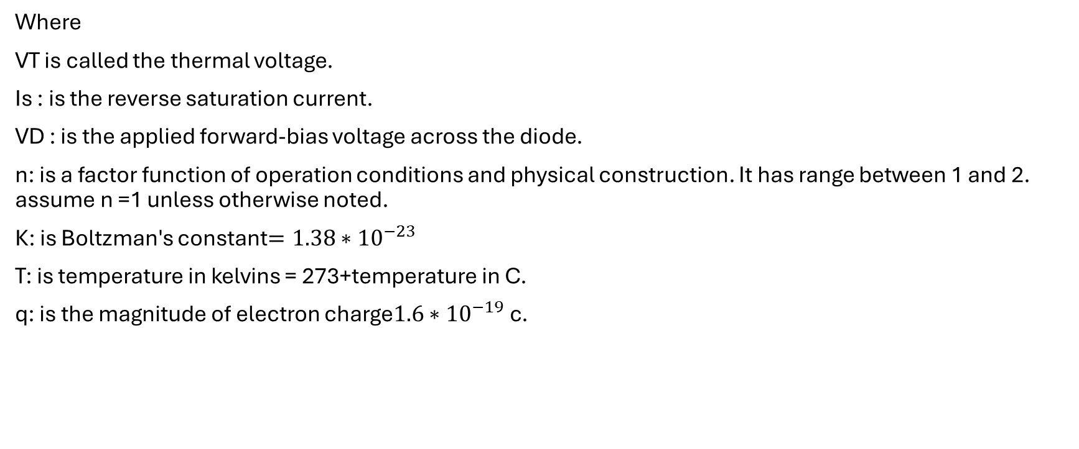

Diode equation
$$I_{D}= I_{S}(e^{\frac{V_{D}}{nV_{T}}}−1)$$
$$V_{T}=\frac{KT}{q}$$
Where
VT is called the thermal voltage.
Is : is the reverse saturation current.
VD : is the applied forward-bias voltage across the diode.
n: is a factor function of operation conditions and physical construction. It has range between 1 and 2. assume n =1 unless otherwise noted.
K: is Boltzman's constant$=1.38∗{10}^{−23}$
T: is temperature in kelvins = 273+temperature in C.
q: is the magnitude of electron charge$1.6∗{10}^{−19}$c.

